Slide 1
BFX-AT100
No Boot FA Report
Prepared by PE : Louis
Date : 2024/09/05

Slide 2
FA Team
Fii | Rakuten
Team Leader: PE Leader: Jack Han TE Leader: Mark QA: Toney Tu Team Members: TE: Allan ME: Wen-tai PE: Michael Ruan/ Luong QA: Ken/ Rachel PM: Roisy | Team Leader: QA: SH son Team Members:

Slide 3
Problem Description
Issue Description (5W1H)
When | 2024-Sep-05
Who | SH Son
Where | ALT customer side
What | No boot issue
Why | TBD
How many | 1pcs / 1600pcs ~ 0.06%, S/N range : 2149688001202404231426
On 05/ Sep, 2024, T99X171.00 model, ALT customer feedback that they found out 1/1600pcs product function test : No boot issue
S/N range : 2149688001202404231426
Defect rate: 0.06% (1/1600 pcs)
Fail symptom: Function check => NG

Slide 4
FA steps And Result
No# | Contents | Result
1 | Confirm Fail Symptom
2 | Production History Data Checking
3 | SPI / AOI History Data checking
4 | No Boot FATP Test Coverage
5
6
7
8
9
10
11

Slide 5
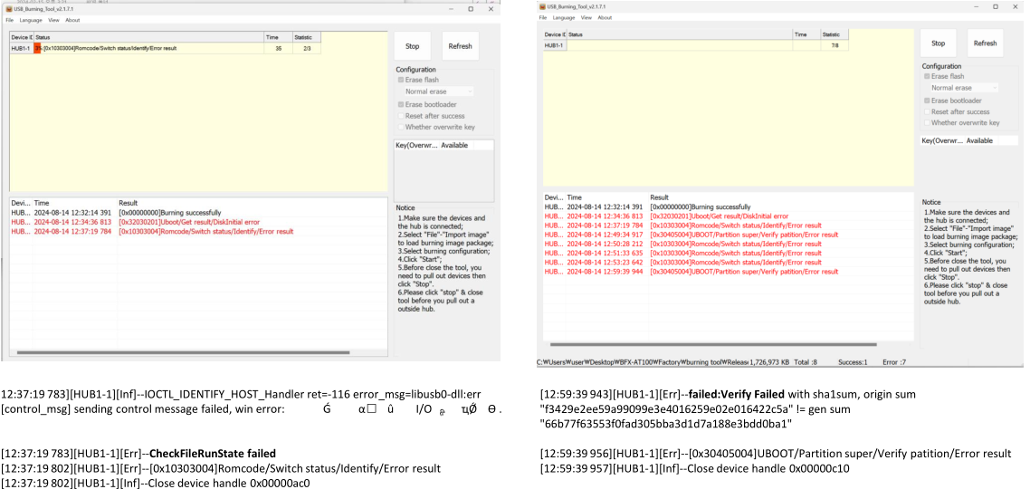
Confirm Fail Symptom
Symptom:
No boot
ALT initial review:
1. Visual check -> No found abnormal.
2. Update check:
- By USB : NG.
- By USB burning tools : NG (Can't download Factory FW (3%) or Can't download Factory FW (97%)
Summary:
NG board no boot and can’ update FW

Slide 6
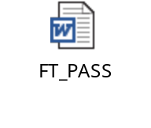
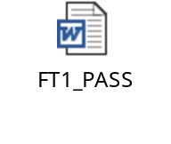

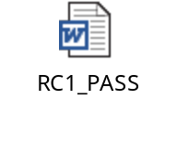

Production History Data Checking
T Level data (SMT)
SN | Test Station
Y0R0Z56 | SMTLOADING | TURNPCB | SPI2 | AOI_2 | INSP | PCB_STOCKIN
 | 24/07/04 10:16 PM | 24/07/05 5:12 PM | 24/07/05 7:30 PM | 24/07/05 8:05 PM | 24/07/05 8:17 PM | 24/07/09 12:50 PM
Dot Level data (FATP )
S/N range | Test Station
2149688001202404231426 | UK | FT | FT1 | RC | RC1 | RC2
 | 24/07/10 2:22 AM | 24/07/10 2:28 AM | 24/07/10 2:37 AM | 24/07/10 2:58 AM | 24/07/10 3:19 AM | 24/07/10 3:25 AM
Test logs | UK test haven’t logs test
Summary:
- This unit has PASSED normally SMT and FATP.
- Shipping date: 2024/07/15 16:17:18

Slide 7
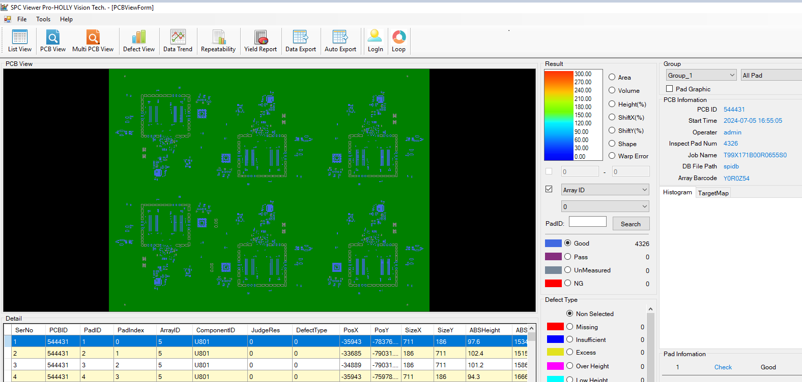
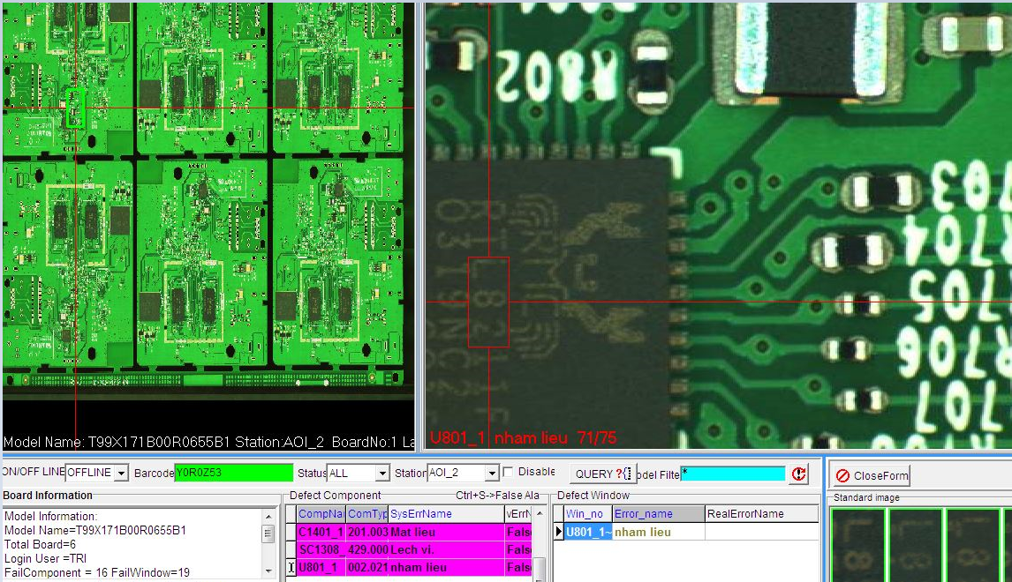
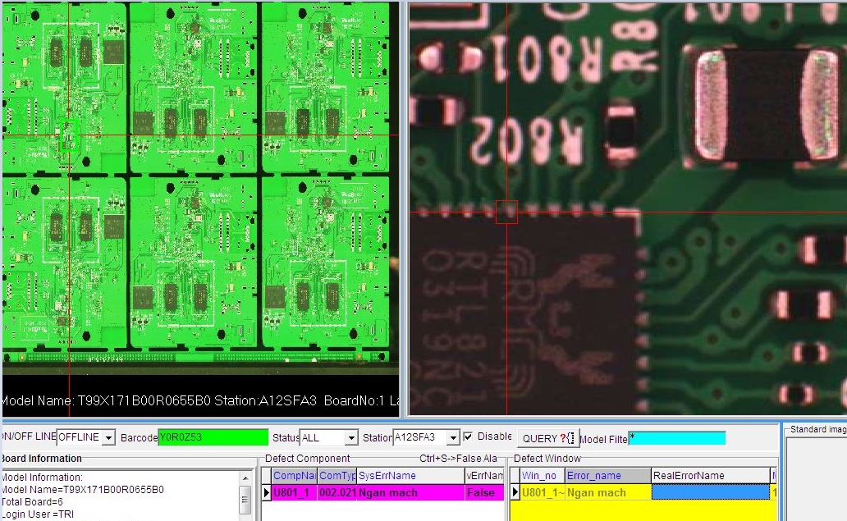
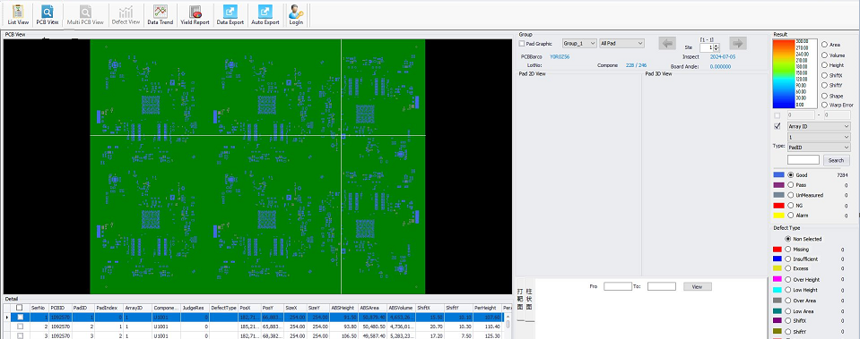
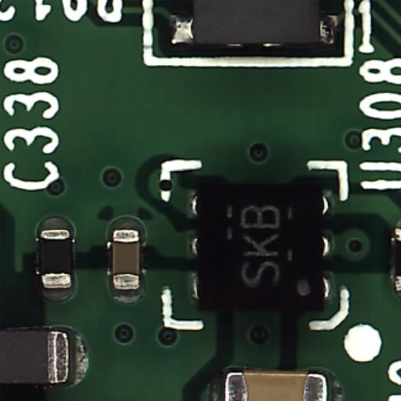
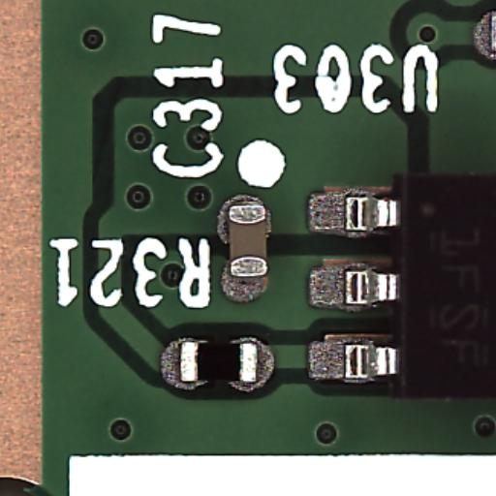
SPI / AOI History Data checking
Side | SPI | Pre-AOI | Post-AOI | Remark
BOT |  |  |  | History data not found issue at SPI & pre-AOI and Post AOI station
TOP |  |  |  | History data not found issue at SPI & pre-AOI and Post AOI station
Result | Good | Normal | Normal
Summary: The SPI & Pre-AOI and Post-AOI not found issue

Slide 8
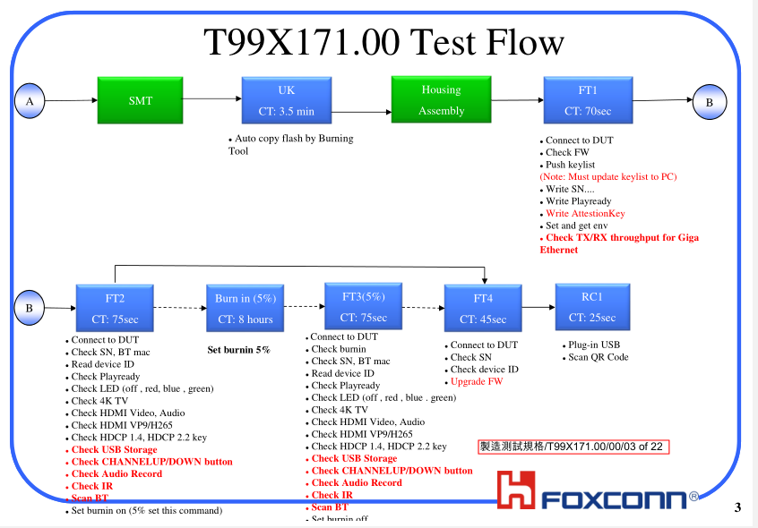
No Boot FATP Test Coverage
FATP process:
Summary :
No boot then can’t test at all station ➔ No boot can cover 100% at FATP

Slide 9
Summary
Summary:
- This unit has PASSED normally SMT and FATP.
- Shipping date: 2024/07/15 16:17:18
- The SPI & Pre-AOI and Post-AOI history not found issue
- No boot can cover 100% at FATP
Action:
- Fii need to get NG board on hand to analysis to find out root cause. Therefore, may can we suggest that ALT send Defective samples back to Vietnam for us to analyze further.

